Slide 1


DIEM INVADERS
C.FUCILE
E.GUZZO
E.MAFFUCCI
M.PREZIOSI
S.SALDUTTI
S.SCALA
R.SQUITIERI
A.TOZZA
B.VENTO

Slide 2

Second sprint’s target
IN THIS SECOND SPRINT WE want to REALIZE THE EVIL BOSS THAT MUST FOLLOW PEPPER AND HE CAN KILL OUR HERO. IN THE GAME THERE IS ALSO A HUD BAR. WE HAVE ALSO CREATED A MAIN MENU IN ORDER TO SET THE DIFFICULTY OF THE GAME, TO START THE GAME OR TO EXIT THE GAME.

Slide 3
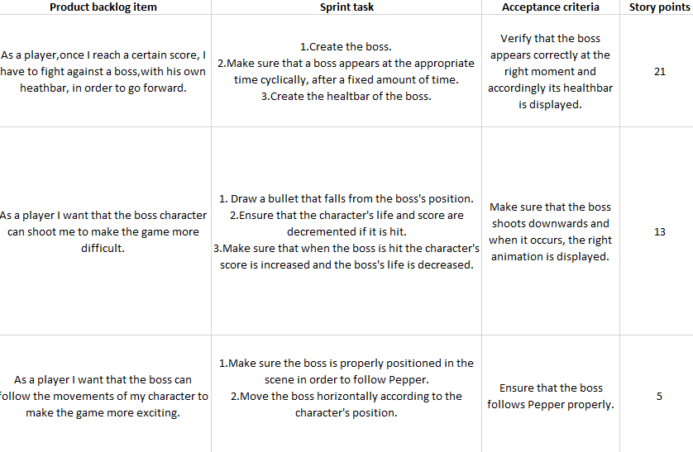
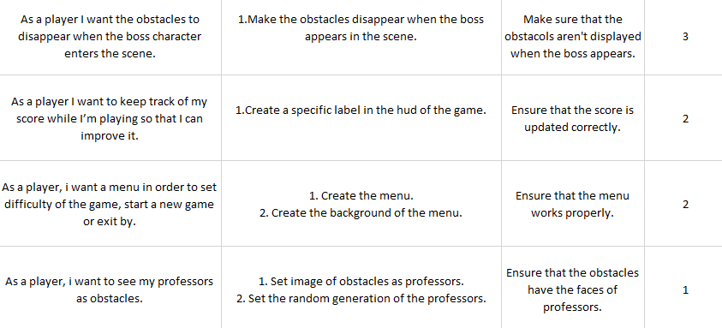
Second sprint’s Product backlog
FIRST PART
SPRINT’S DURATION: 2 WEEKS
SPRINT’S ESTIMATED VELOCITY: 67

Slide 4
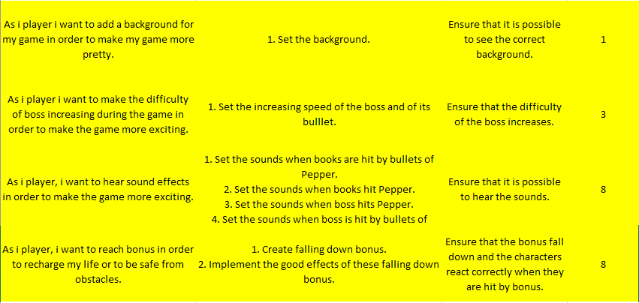
Second sprint’s Product backlog
SECOND PART
SPRINT’S DURATION: 2 WEEKS
SPRINT’S ESTIMATED VELOCITY: 67

Slide 5
Tasks performed
CREATING THE ENEMY BOSS, ITS HEALTH BAR AND ITS BULLETS;
IMPLEMENTING OF THE SCORE;
CHANGING THE IMAGE OF OBSTACLES;
MANAGE THE DISAPPEARANCE OF THE BOOKS BEFORE THE CREATION OF THE BOSS;
IMPLEMENTATION OF THE MAIN GAME MENU;

Slide 6
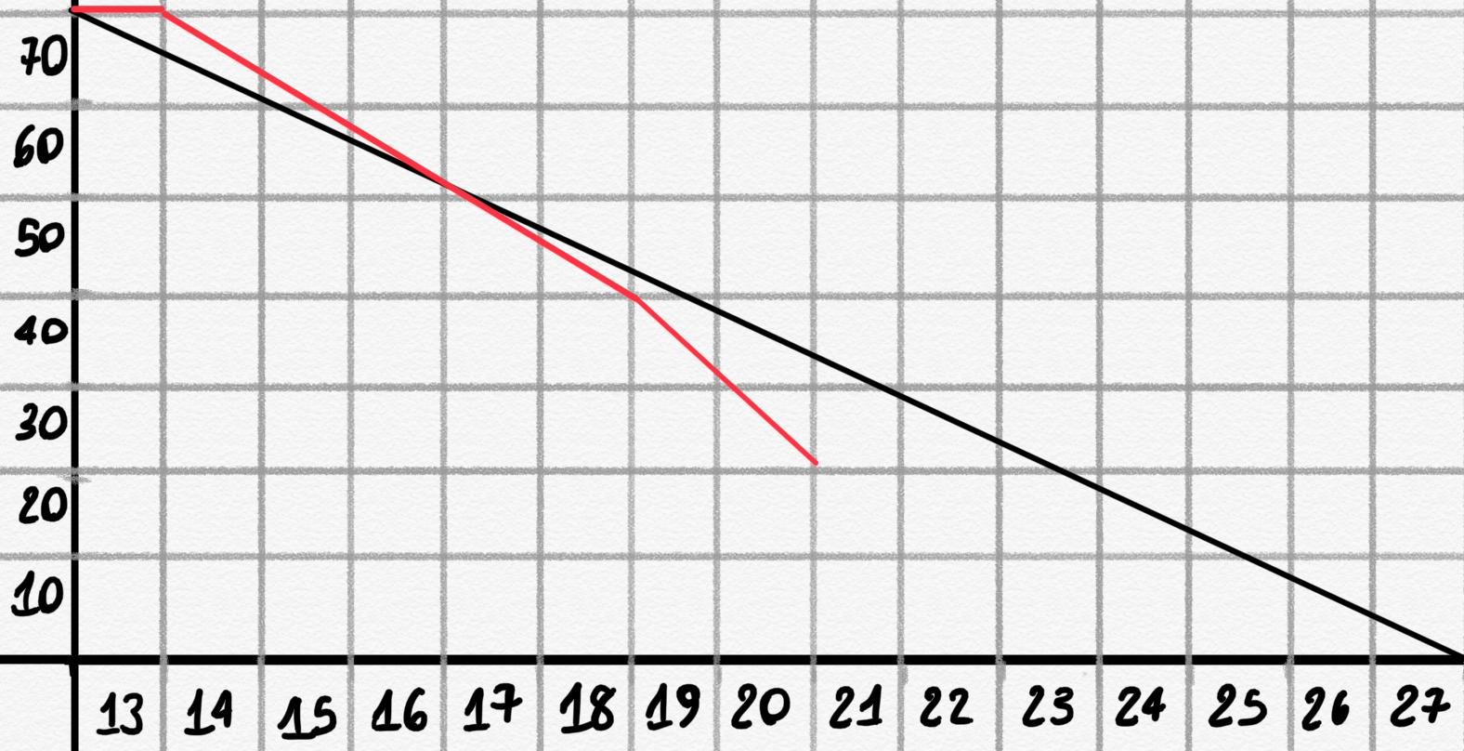
BURN DOWN CHART
START SPRINT: 13° DECEMBER
END SPRINT: 27° DECEMBER
IDEAL SITUATION
REAL SITUATION

Slide 7

demo

Slide 8
FOR TODAY WE CAN STOP HERE!

